Slide 1
Warm-up
Producers, organisms who make their own food are called __________.
Consumers, organisms who cannot make their own food are ____________.
Another word for stable internal conditions is _____________.
Homework: None

Slide 2
Warm-up
Producers, organisms who make their own food are called autotrophs.
Consumers, organisms who cannot make their own food are heterotrophs.
Another word for stable internal conditions is homeostasis.
Homework: None

Slide 3
6 Kingdoms Notes

Slide 4
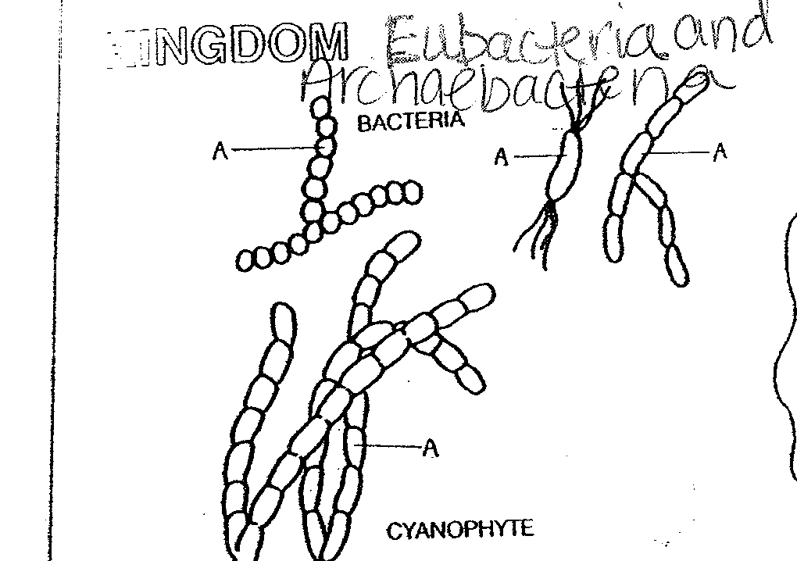
Kingdom Eubacteria and Archaebacteria
No longer called Monera, now split into two kingdoms.
Simplest of all life forms.
There are both helpful and harmful bacteria

Slide 5
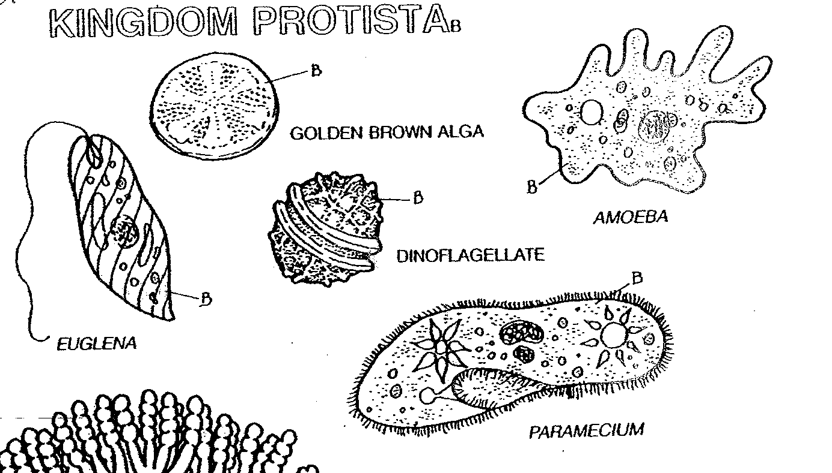
Kingdom Protista
Organisms that don’t fit into any other kingdom.
They live in wet or moist environments.
Most are unicellular.

Slide 6
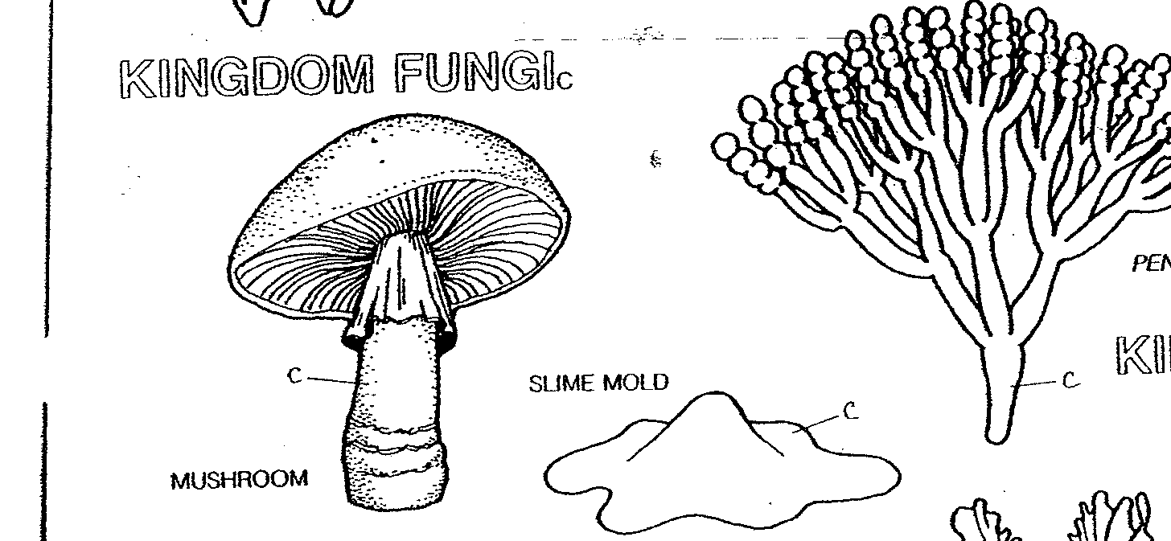
Kingdom Fungi
Live in a humid environment
Importance: food, medicine, decomposers

Slide 7
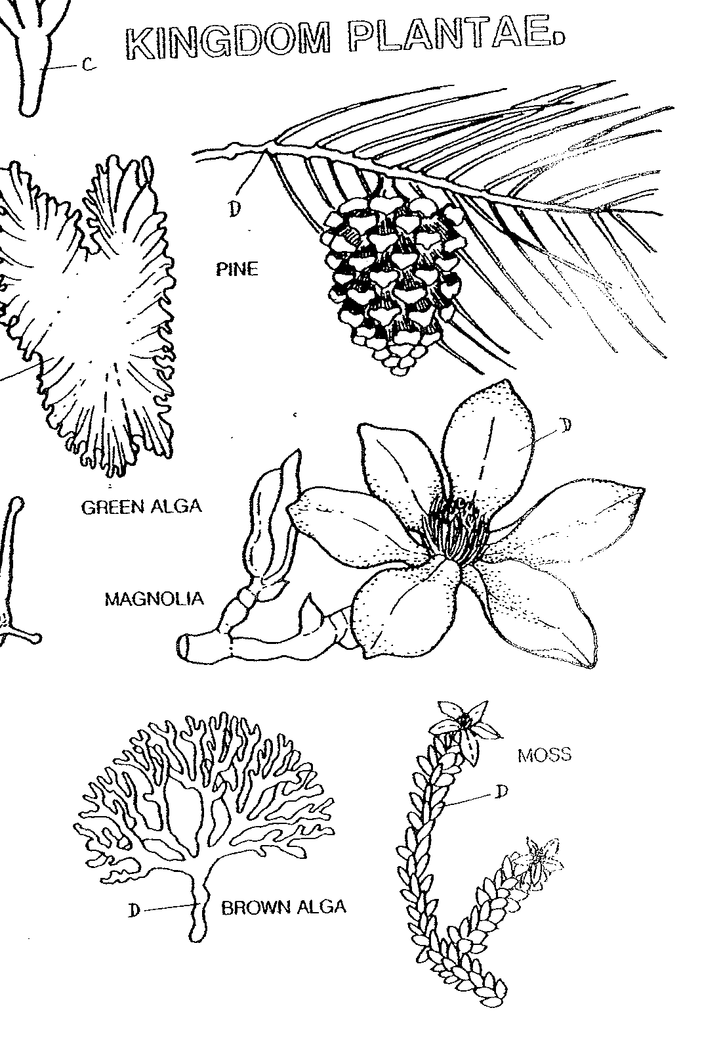
Kingdom Plant
Multicellular Autotrophs who make their own food through photosynthesis

Slide 8
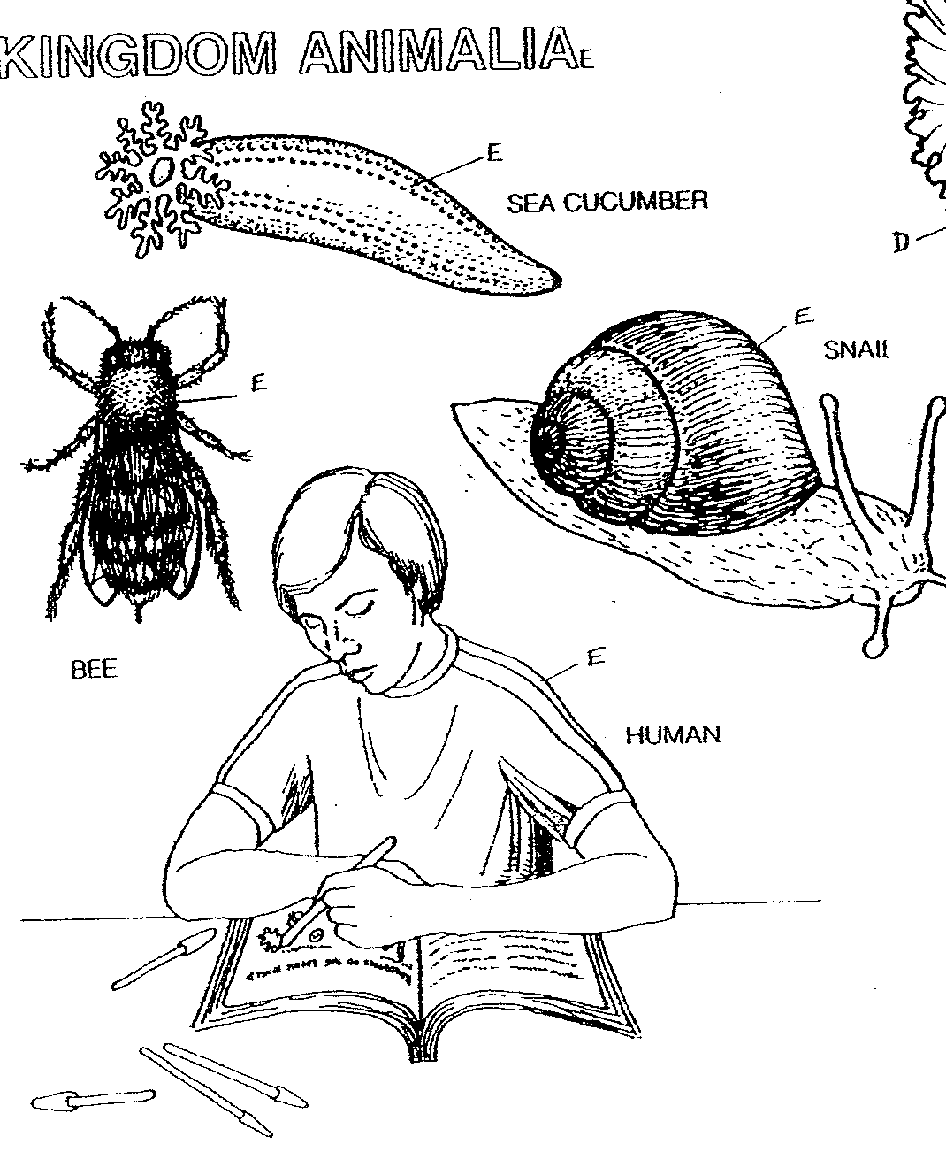
Kingdom Animal
Divided into vertebrates and invertebrates.
Multicellular
Heterotrophs

