Slide 1
Digestive System Notes

Slide 2
Digestion
The process of changing food into liquids to be absorbed by the body.

Slide 3
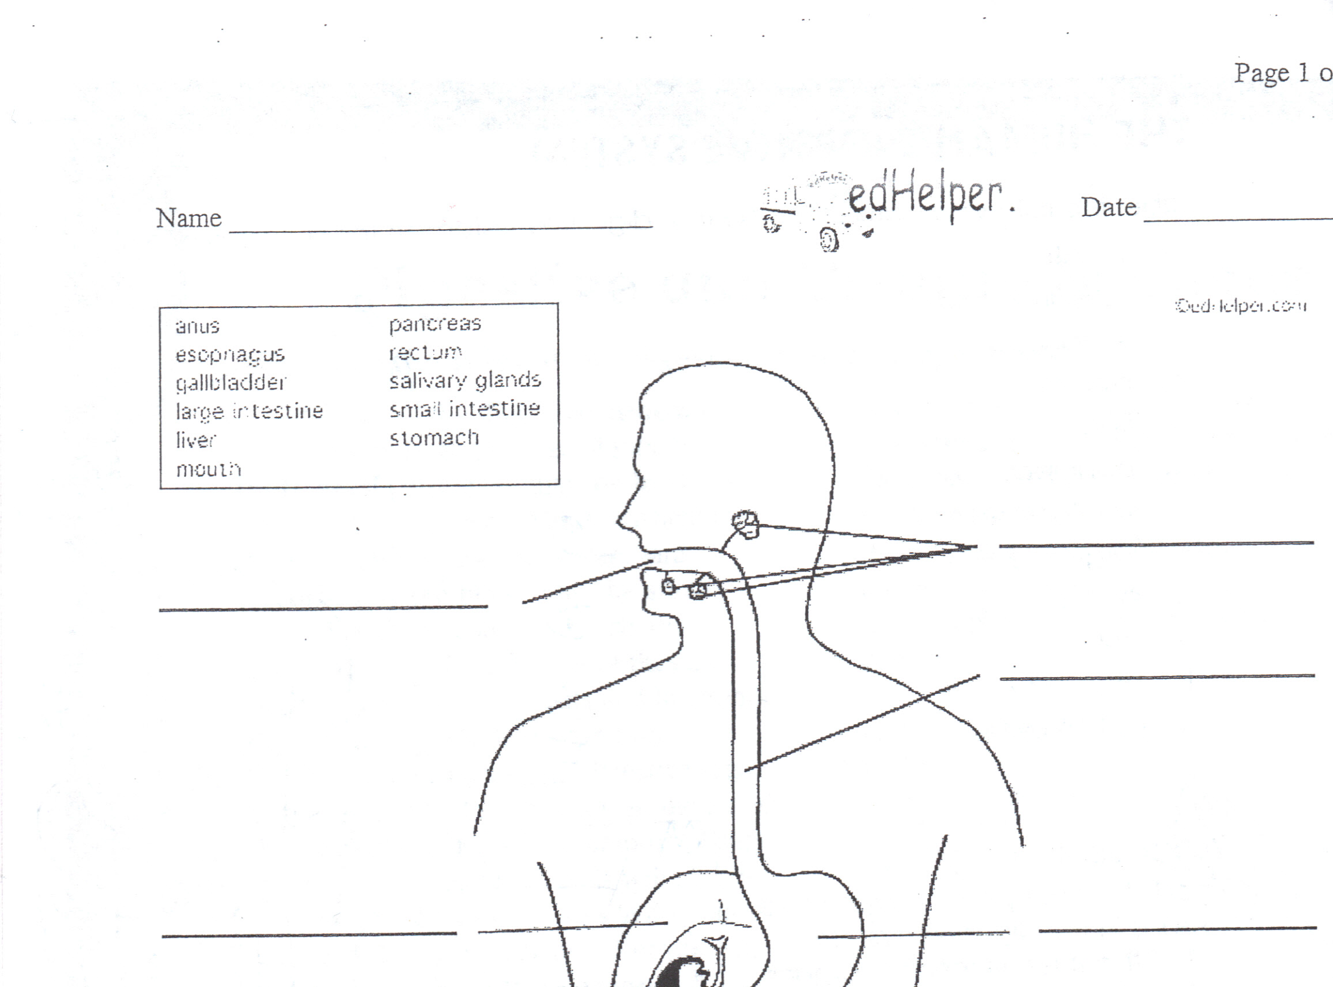

Slide 4
Peristalsis-The action of food being pushed along the digestive tract

Slide 5
Peristalsis-The action of food being pushed along the digestive tract
2 types of digestion:
Physical=chewing Chemical = uses enzymes (chemicals)

Slide 6
Peristalsis-The action of food being pushed along the digestive tract
2 types of digestion:
Physical=chewing Chemical = uses enzymes (chemicals)
Mouth- The teeth physically break down food while the tongue mixes food with saliva.

Slide 7
Peristalsis-The action of food being pushed along the digestive tract
2 types of digestion:
Physical=chewing Chemical = uses enzymes (chemicals)
Salivary Glands- Saliva begins to chemically break down food in your mouth.
Mouth- The teeth physically break down food while the tongue mixes food with saliva.

Slide 8
Peristalsis-The action of food being pushed along the digestive tract
2 types of digestion:
Physical=chewing Chemical = uses enzymes (chemicals)
Salivary Glands- Saliva begins to chemically break down food in your mouth.
Mouth- The teeth physically break down food while the tongue mixes food with saliva.
Esophagus-The “food tube”-muscles in its walls push food into the stomach.

Slide 9
Peristalsis-The action of food being pushed along the digestive tract
2 types of digestion:
Physical=chewing Chemical = uses enzymes (chemicals)
Salivary Glands- Saliva begins to chemically break down food in your mouth.
Mouth- The teeth physically break down food while the tongue mixes food with saliva.
Esophagus-The “food tube”-muscles in its walls push food into the stomach.
Stomach-This organ churns the food and mixes it with hydrochloric acid to help break food down chemically.

Slide 10
Peristalsis-The action of food being pushed along the digestive tract
2 types of digestion:
Physical=chewing Chemical = uses enzymes (chemicals)
Salivary Glands- Saliva begins to chemically break down food in your mouth.
Mouth- The teeth physically break down food while the tongue mixes food with saliva.
Esophagus-The “food tube”-muscles in its walls push food into the stomach.
Chyme- Watery, partially broken-down food that is mixed with stomach acids and enzymes
Liver-Creates bile, which breaks down large fats particles in the chyme .
Stomach-This organ churns the food and mixes it with hydrochloric acid to help break food down chemically.

Slide 11
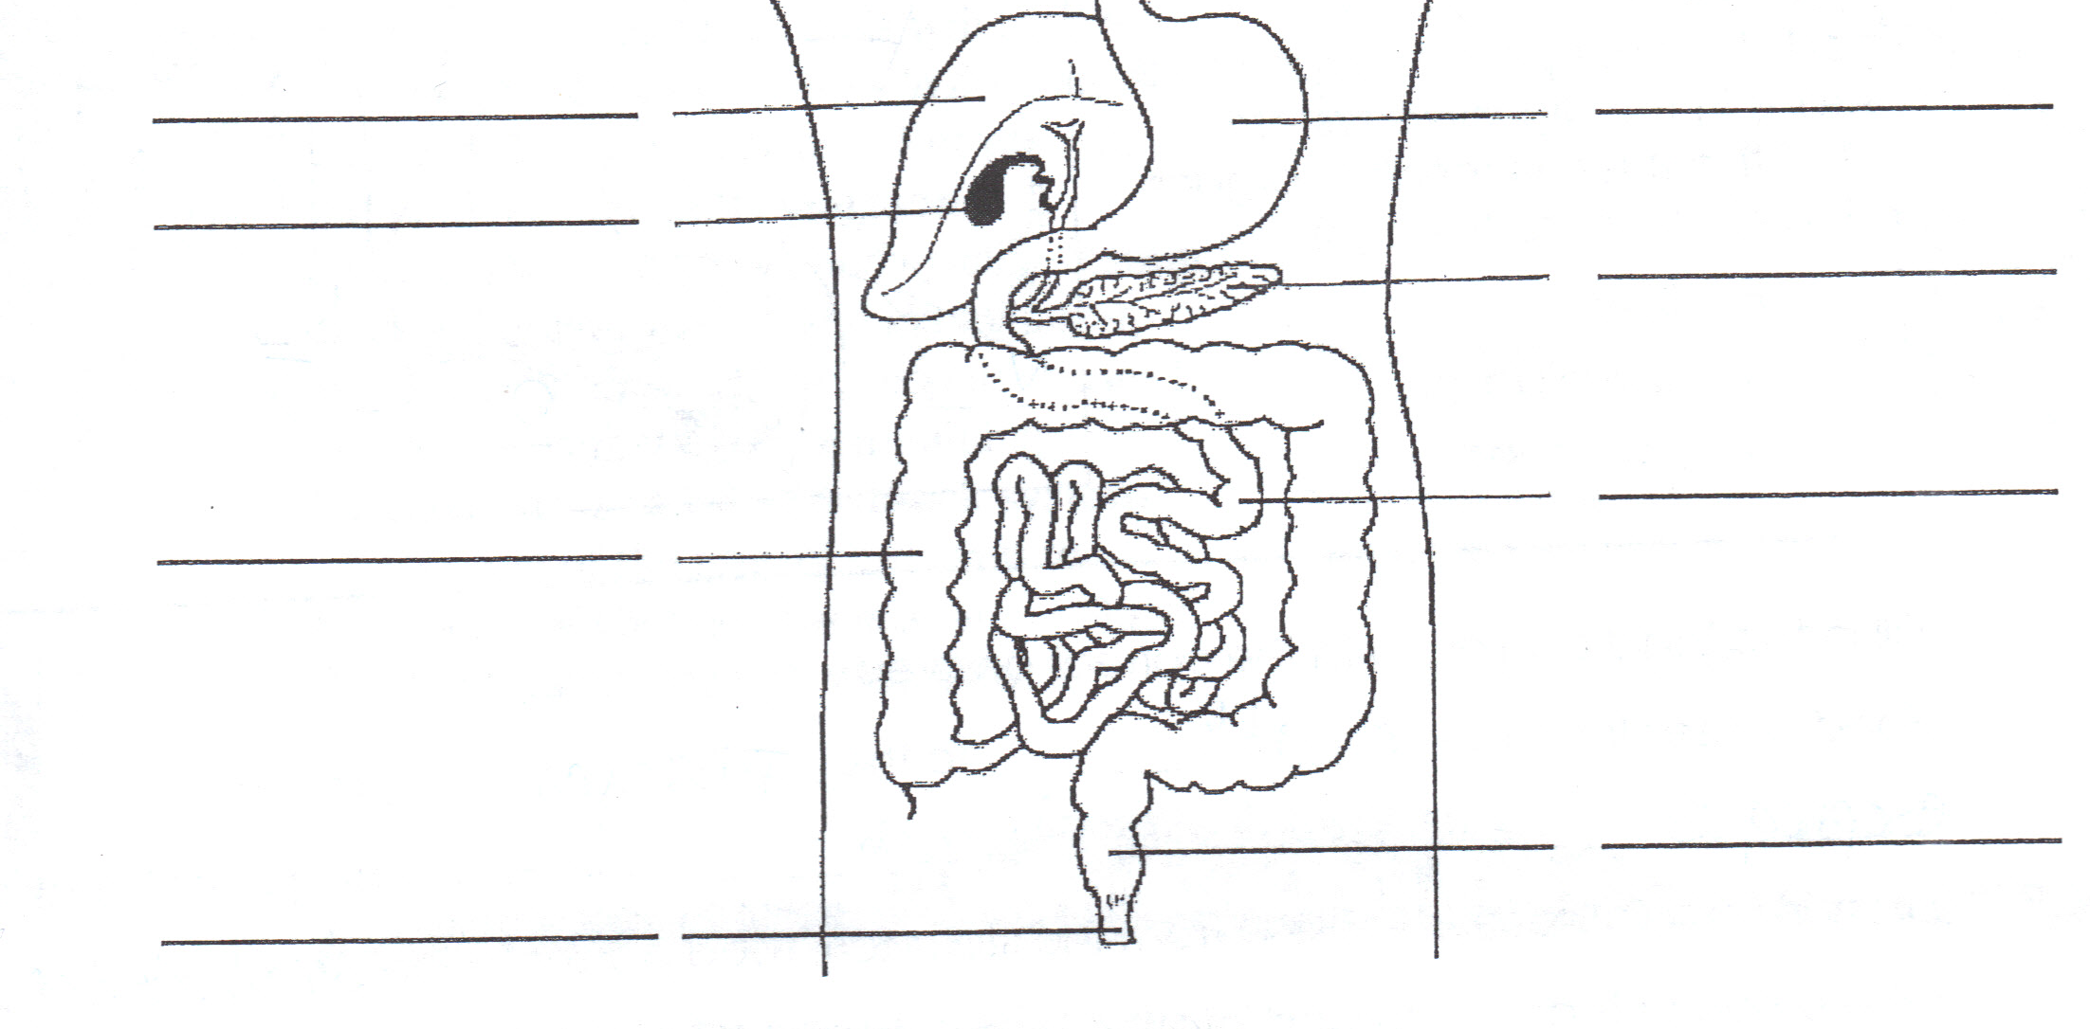
Liver-Creates bile, which breaks down large fats particles in the chyme .
Stomach-This organ churns the food and mixes it with hydrochloric acid to help break food down chemically.
Gall Bladder- stores bile

Slide 12
Liver-Creates bile, which breaks down large fats particles in the chyme .
Stomach-This organ churns the food and mixes it with hydrochloric acid to help break food down chemically.
Gall Bladder- stores bile
Pancreas-An organ that adds enzymes to food to help break it down in the small intestine.

Slide 13
Liver-Creates bile, which breaks down large fats particles in the chyme .
Stomach-This organ churns the food and mixes it with hydrochloric acid to help break food down chemically.
Gall Bladder- stores bile
Pancreas-An organ that adds enzymes to food to help break it down in the small intestine.
Small Intestine-
Food (chyme) is further
broken down with bile and enzymes and is absorbed.

Slide 14
Liver-Creates bile, which breaks down large fats particles in the chyme .
Stomach-This organ churns the food and mixes it with hydrochloric acid to help break food down chemically.
Gall Bladder- stores bile
Pancreas-An organ that adds enzymes to food to help break it down in the small intestine.
Large Intestine-The muscular walls of this organ absorb water from undigested food and push the remaining wastes out of your body.
Small Intestine-
Food (chyme) is further
broken down with bile and enzymes and is absorbed.

Slide 15
Liver-Creates bile, which breaks down large fats particles in the chyme .
Stomach-This organ churns the food and mixes it with hydrochloric acid to help break food down chemically.
Gall Bladder- stores bile
Pancreas-An organ that adds enzymes to food to help break it down in the small intestine.
Large Intestine-The muscular walls of this organ absorb water from undigested food and push the remaining wastes out of your body.
Small Intestine-
Food (chyme) is further
broken down with bile and enzymes and is absorbed.
Rectum- The last
6 to 8 inches of the large intestine which stores solid waste until it leaves
the body.

Slide 16
Liver-Creates bile, which breaks down large fats particles in the chyme .
Stomach-This organ churns the food and mixes it with hydrochloric acid to help break food down chemically.
Gall Bladder- stores bile
Pancreas-An organ that adds enzymes to food to help break it down in the small intestine.
Large Intestine-The muscular walls of this organ absorb water from undigested food and push the remaining wastes out of your body.
Small Intestine-
Food (chyme) is further
broken down with bile and enzymes and is absorbed.
Rectum- The last
6 to 8 inches of the large intestine which stores solid waste until it leaves
the body.
Anus- opening through which solid waste leaves the body.

Slide 17
Liver-Creates bile, which breaks down large fats particles in the chyme .
Stomach-This organ churns the food and mixes it with hydrochloric acid to help break food down chemically.
Gall Bladder- stores bile
Pancreas-An organ that adds enzymes to food to help break it down in the small intestine.
Large Intestine-The muscular walls of this organ absorb water from undigested food and push the remaining wastes out of your body.
Small Intestine-
Food (chyme) is further
broken down with bile and enzymes and is absorbed.
Rectum- The last
6 to 8 inches of the large intestine which stores solid waste until it leaves
the body.
Anus- opening through which solid waste leaves the body.

